Slide 1
Exploratory Data Analysis on Heart Disease Dataset
Anil - C0938253
Richard - C0932997
Mahidhar - C0936754
Vijay - C0913018
Jignesh - C0935085

Slide 2
Dataset Overview
Feature | Description
age | Age in years
sex | Sex (1 = male; 0 = female)
chest pain type | chest pain type -- Value 1: typical angina -- Value 2: atypical angina -- Value 3: non-anginal pain -- Value 4: asymptomatic
resting bp s | Resting blood pressure (in mm Hg on admission to the hospital)
cholestoral | Serum cholestoral in mg/dl
fasting blood sugar | Fasting blood sugar > 120 mg/dl (1 = true; 0 = false)
resting ecg | resting electrocardiographic results -- Value 0: normal -- Value 1: having ST-T wave abnormality (T wave inversions and/or ST elevation or depression of > 0.05 mV) -- Value 2: showing probable or definite left ventricular hypertrophy by Estes' criteria
max heart rate | Maximum heart rate achieved
exercise angina | Exercise induced angina (1 = yes; 0 = no)
oldpeak | ST depression induced by exercise relative to rest
ST slope | the slope of the peak exercise ST segment -- Value 1: upsloping -- Value 2: flat -- Value 3: downsloping
target | diagnosis of heart disease (angiographic disease status) -- Value 0: < 50% diameter narrowing -- Value 1: > 50% diameter narrowing
The dataset contains 1190 rows and 12 columns.
Each row represents a patient, and columns represent various attributes related to heart disease risk factors.

Slide 3
Introduction
Heart disease remains a leading cause of mortality worldwide, emphasizing the need for effective data analysis to understand and predict the risk factors associated with it. This report provides an in-depth analysis of a dataset containing heart disease-related information, aimed at identifying significant factors that contribute to heart disease. The dataset comprises various features, including demographic and clinical variables, which are analyzed to gain insights into their impact on heart disease occurrence.

Slide 4
Exploratory Data Analysis
The purpose of this exploratory data analysis (EDA) is to uncover insights and trends within the heart disease dataset.
EDA helps understand the underlying patterns, identify relationships among variables, and guide further analysis or model development.

Slide 5
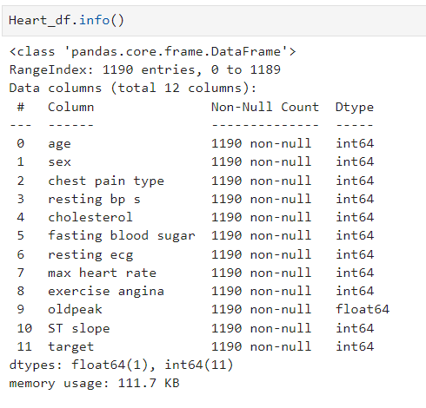
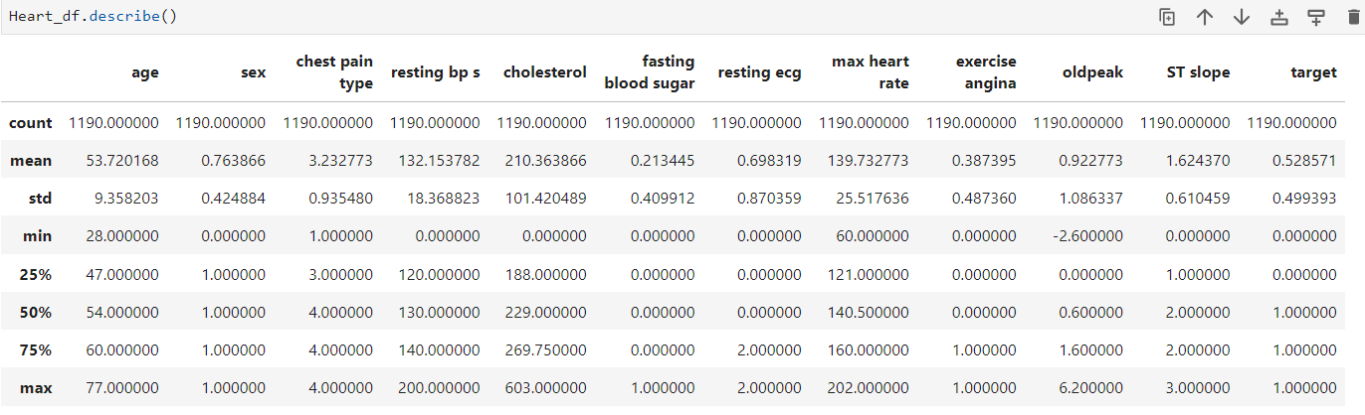
Data Exploration
Understanding the completeness and structure of the data is critical before proceeding with analysis or modelling.
Check the Data types
Check for Missing values

Slide 6
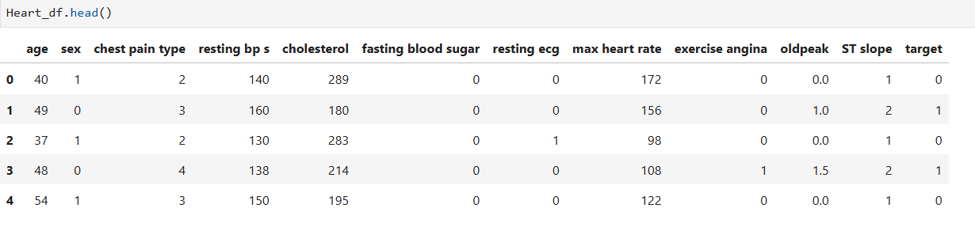
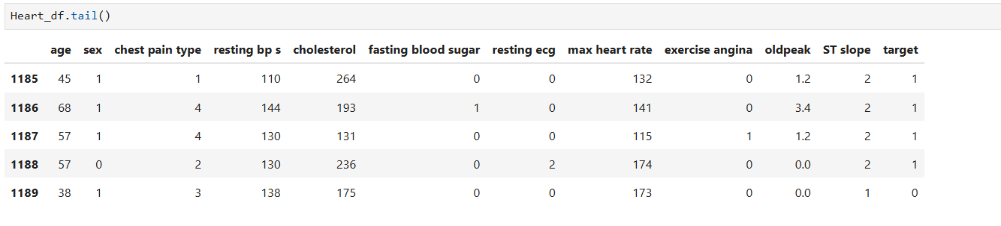
Data Exploration

Slide 7
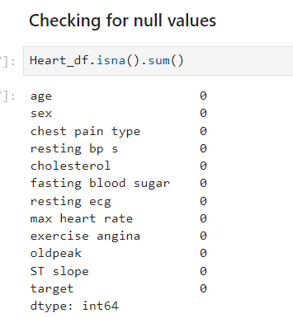
Missing or null values
There are no null values present in the dataset.
Moving on we can analyze the distribution of the records across various features.

Slide 8
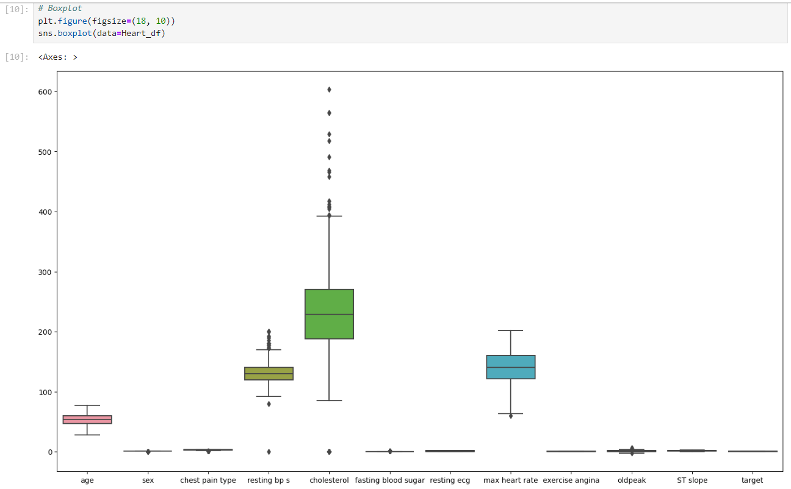
Box Plot
We observed outliers in columns resting bp s, cholesterol and max heart rate
Also, extreme outliers can be seen for column cholesterol

Slide 9
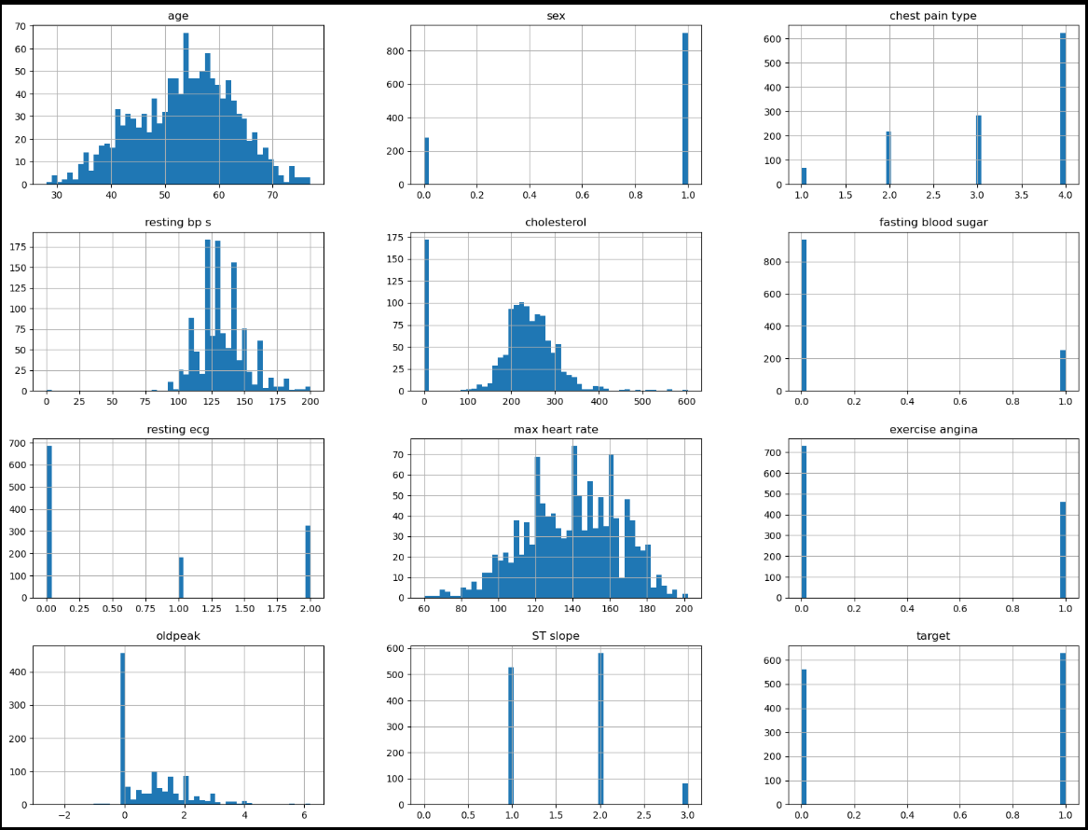
Histogram
We can see that sex, chest pain type , resting ecg, fasting blood sugar, exercise angina, ST slope and target are categorical fields

Slide 10
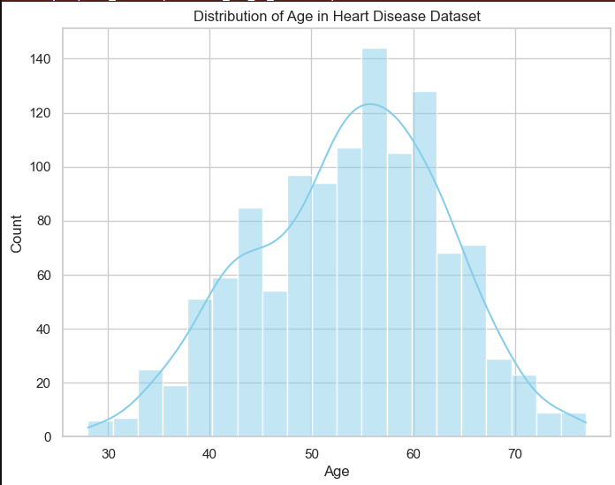
Age Distribution
Age distribution is similar to Normal Distribution with the mean around 57.

Slide 11
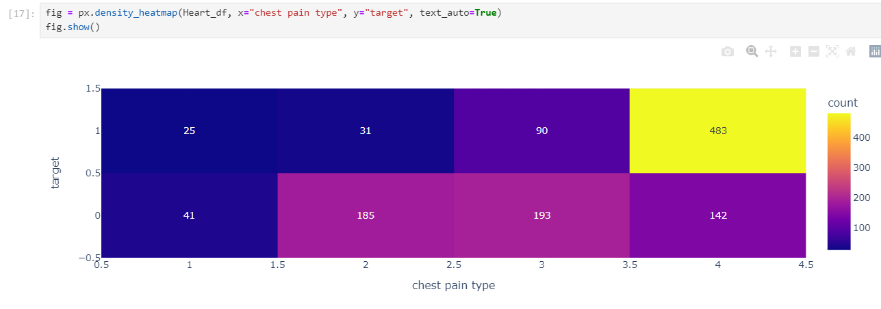
Density heat map
Chest pain type vs target :

Slide 12
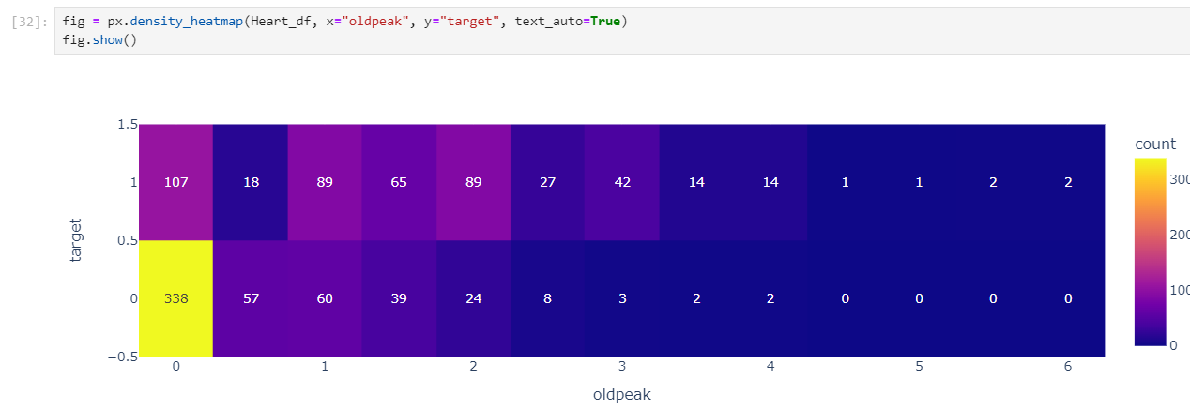
Oldpeak vs target :

Slide 13
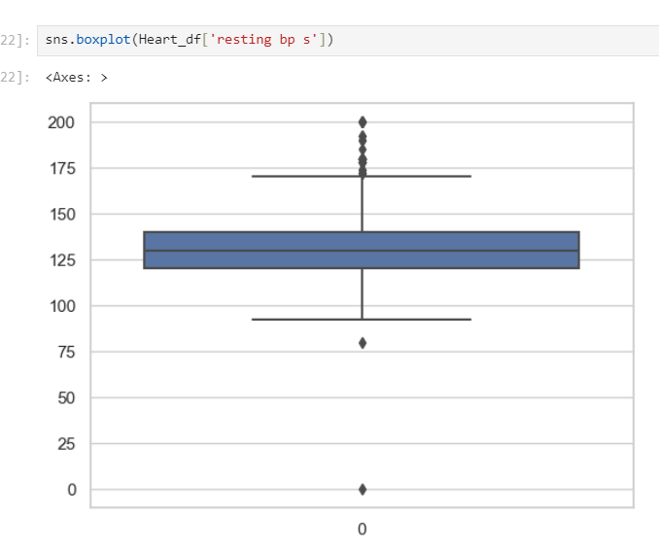
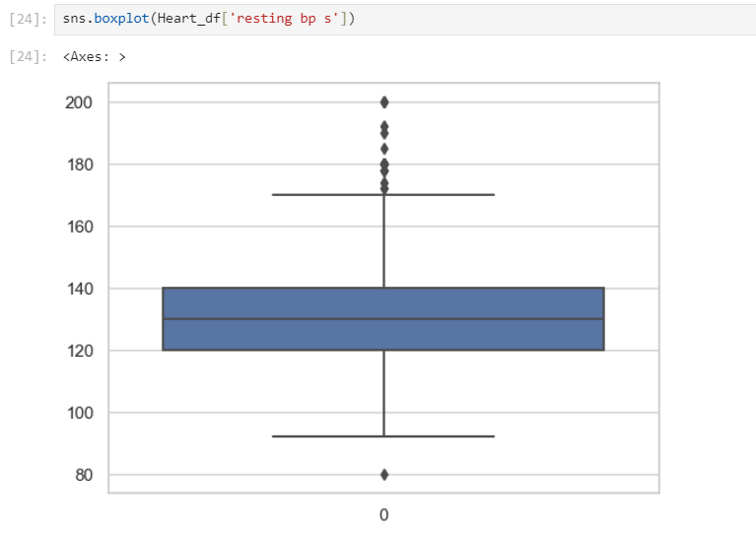

Outlier Detection and handling
Before:
After:

Slide 14
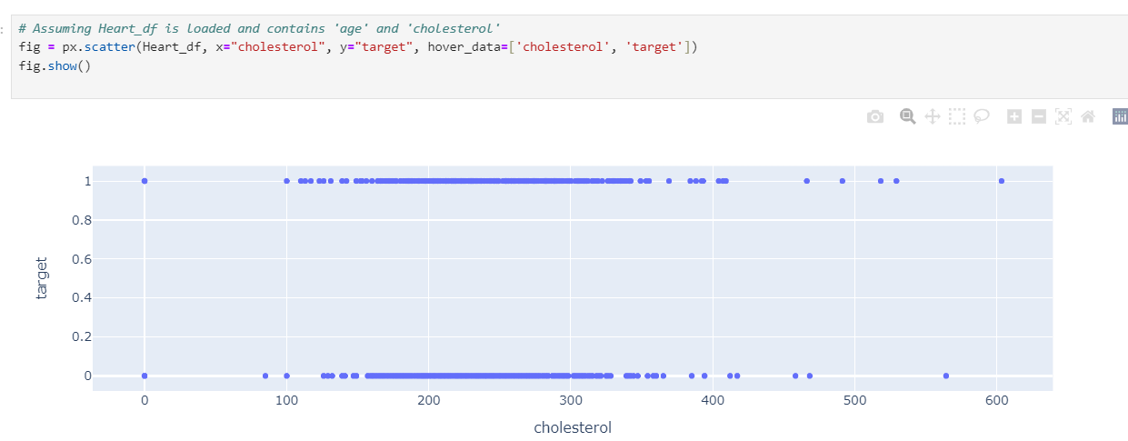
Before outlier handling

Slide 15
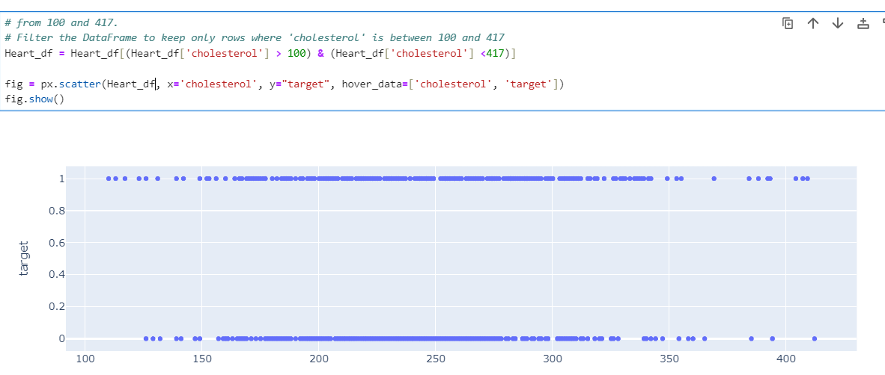
After outlier handling

Slide 16
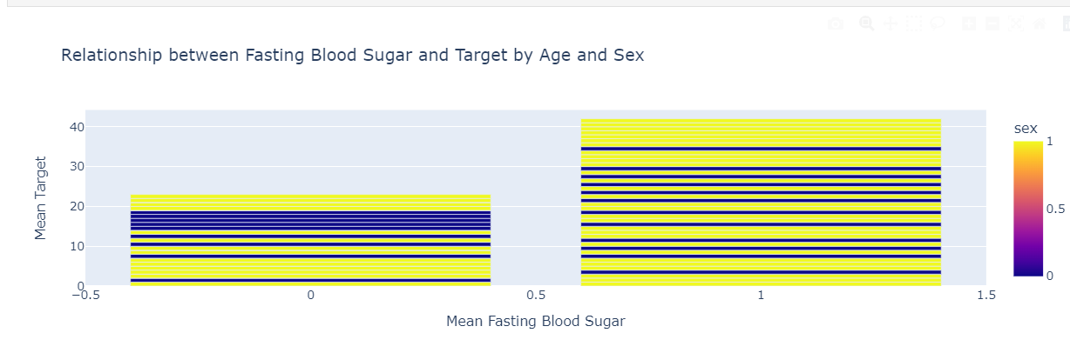
Fasting Blood Sugar and Target

Slide 17
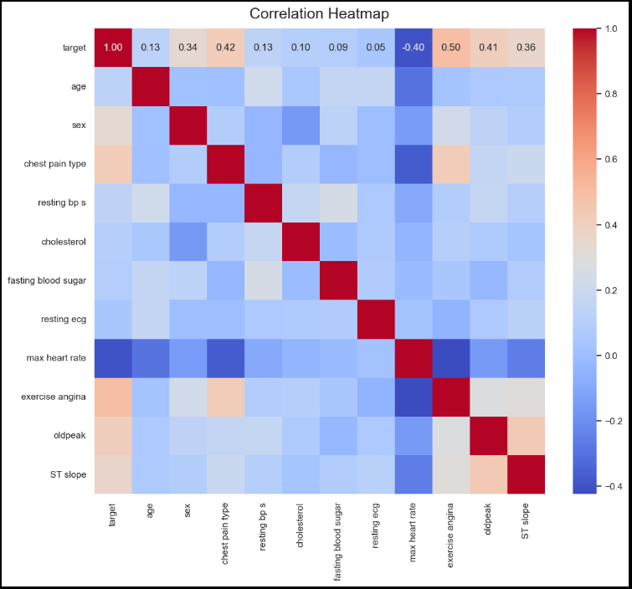
Heatmap
Strongest Positive Correlations:
Exercise angina, chest pain type and ST slope with the target.
Strongest Negative Correlations:
Maximum heart rate with the target

Slide 18
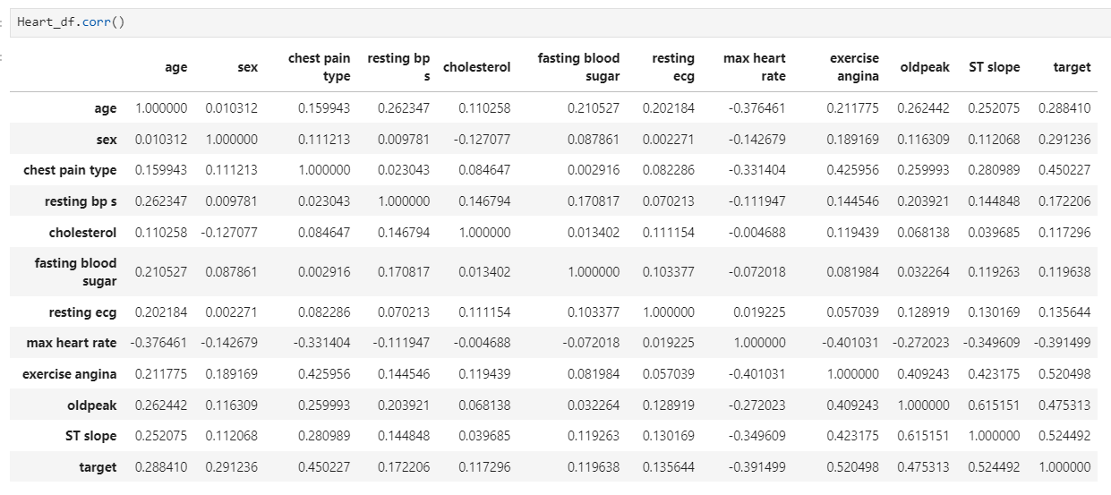
Correlation Matrix

Slide 19
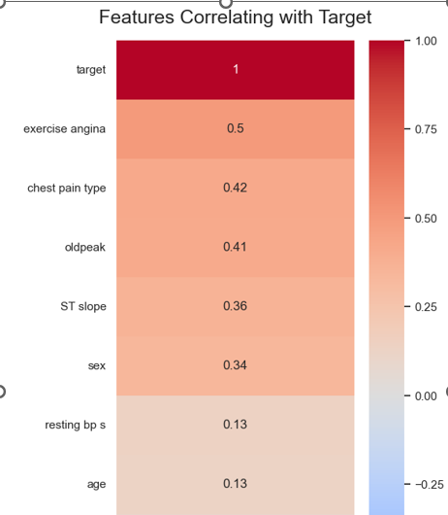
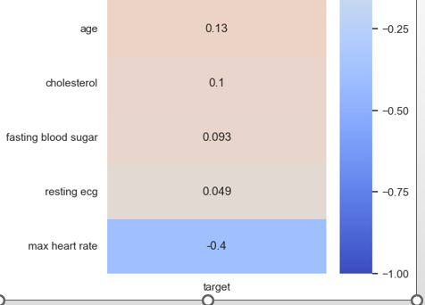
Feature correlation with target
:

Slide 20
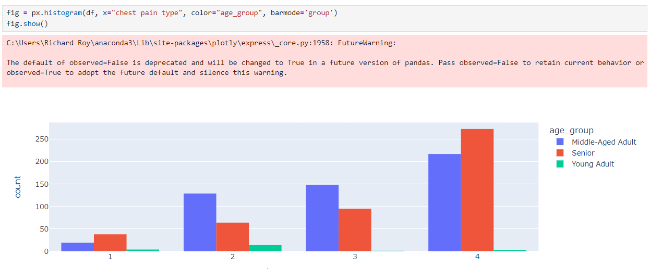
Binning age into age group

Slide 21
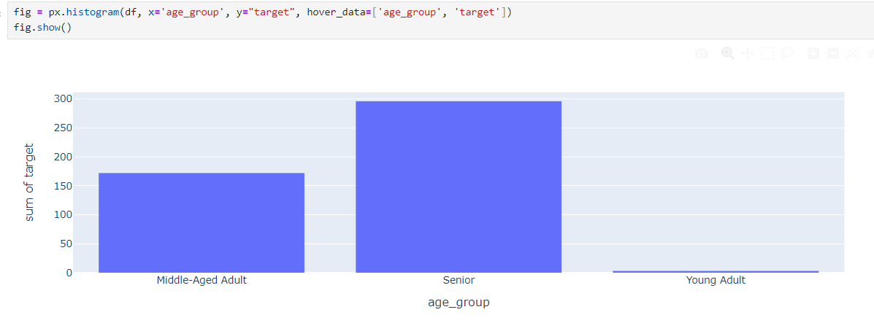
Histogram
Age group Distribution vs Target:

Slide 22
Conclusion
This analysis successfully identifies key features and relationships that are indicative of heart disease risk. The most significant predictors include max heart rate, exercise angina, and chest pain type. Future work should focus on:
A classification model will help predict the target.
Model Building: Developing predictive models using these features to enhance the accuracy of heart disease risk prediction.
Feature Engineering: Exploring additional feature engineering techniques and incorporating more advanced statistical methods.
Data Expansion: Incorporating more diverse datasets to validate findings and improve model robustness.

Slide 23
Thank You

